Slide 1

THE SHA₹P(E) PO₹TFOLIO SOLUTION
Mentored by:
Prof. Jagbandhu Padhy
Prof. Sharad Ratihalli
By:
Dharmi Gala A014
Dhruv Goyal A018
Aman Jain A021
Mahi Shah A037

Slide 2
TABLE OF CONTENTS
1. Objective
2. Assumptions
3. About the Data
4. Fundamental Analysis
5. Black Litterman Model
6. Sharpe Ratio Optimization
7. Advisory Tool
8. Dashboard
9. Limitations & Future Scope

Slide 3
To allocate a portfolio to an investor according to the investor's degree of risk aversion and creating an advisory tool to facilitate the allocation
OBJECTIVE
Model Used: Black Litterman Model
Techniques Used: Fundamental Analysis, Sharpe Ratio Optimization, Regression Analysis

Slide 4
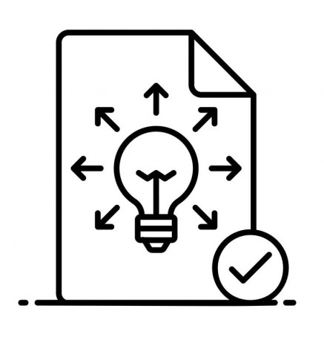
ASSUMPTIONS
Portfolio is created in March ’19
Mean is a good measure of central tendency for ratios
Accounting policies are standard across all firms
Investor holds adequate funds
Assumption of investor’s rationality
All assumptions holding true for
Black Litterman Model
Sharpe Optimisation
Notes:
We are in march 19 rn
All assumptions applicable to bl, sharpe, regression
Mean is a good measure of central tendency.
Accounting policies are standard across all companies
No cap on investment as pooling
Rational investors

Slide 5



ABOUT THE DATA
National Stock Exchange (NSE)
5 Sectors :
Information and Technology (IT)
Pharmaceuticals
Bank
Energy
Fast Moving Consumer Goods (FMCG)
163 Stocks
State Bank of India (SBI) Fixed Deposit
Notes:
Excel:company info
Exchange: NSE
How many sector – how many have we chose, total stocks, why

Slide 6
FUNDAMENTAL ANALYSIS
Ratios Used:
Price-to-Earnings (P/E)
Debt-to-Equity (D/E)
Quick Ratio (QR)
Return on Equity (ROE)
Current Account Savings Account (CASA)
Capital Adequacy Ratio (CAR)
Energy Sector
BPCL
GAIL
GUJARAT GAS
HPCL
INDRAPRASTHA GAS
IOC
ONGC
PETRONET LNG
RELIANCE IND.
GUJARAT GAS
HPCL
INDRAPRASTHA GAS
IOC
PETRONET LNG
Energy Sector - Large Cap
Notes:
Price-to-Earnings (P/E) - Valuation
Debt-to-Equity (D/E) - Leverage
Quick Ratio - Liquidity
Return on Equity (ROE) - Returns
Current Account Savings Account (CASA) – Bank Liquidity
Capital Adequacy Ratio (CAR) – Bank Liquidity

Slide 7
FUNDAMENTAL ANALYSIS
Ratios Used:
Price-to-Earnings (P/E)
Debt-to-Equity (D/E)
Quick Ratio (QR)
Return on Equity (ROE)
Current Account Savings Account (CASA)
Capital Adequacy Ratio (CAR)
Other Thresholds:
Small Cap
Mid Cap
Large Cap
D/E | <1 | QR | >1 | ROE | >15%
CASA | >12% | CAR | >12%
Further elimination by - Value at Risk (VaR) & Downside Variance.
Notes:
Price-to-Earnings (P/E) - Valuation
Debt-to-Equity (D/E) - Leverage
Quick Ratio - Liquidity
Return on Equity (ROE) - Returns
Current Account Savings Account (CASA) – Bank Liquidity
Capital Adequacy Ratio (CAR) – Bank Liquidity
Say: Replicate real word process
Theory
Divided small large mid cap
Financial ratios – in the order we used them
Thresholds (can do stacked)
Final company info (+filtered)
Stocks remaining - 16
Top 33% row for each sector

Slide 8
FINAL SHORTLISITING
513570
612343
213570
612342
313570
812342
1
13570
812342
213570
512342
IT
Pharma
Bank
Energy
FMCG
163 stocks
Notes:
Historical monthly data from aug 16 – march 2021
Where 16-19 is training and 19-21 is test but not literally
Calculated various measures of risk and came down to an equity portfolio of 11 stocks
Excel: shortlisted companies

Slide 9
612343
612342
812342
812342
512342
513570
213570
313570
1
13570
213570
FINAL SHORTLISITING
IT
Pharma
Energy
Pharma
Bank
Energy
FMCG
11 stocks
Notes:
We are in march 19 rn
All assumptions applicable to bl, sharpe, regression
Mean is a good measure of central tendency.
Accounting policies are standard across all companies
No cap on investment as pooling
Rational investors

Slide 10

BLACK LITTERMAN MODEL
Used to calculate Expected Returns
Developed to overcome the limitations of the Modern Portfolio Theory (MPT)
Makes use of market data as well as portfolio manager's views, hence it is a holistic approach
Assumptions
Every view is independent
Market returns follow normal distribution
Initial weights have been assigned according to market cap of each stock
(Satchell & Scowcrowft Model)
Limitations
Sensitive to investor inputs
Views are constrained to returns only
$τ$ = 1
$$E\left(R\right)−R_{f}={[{\left(τS\right)}^{−1}+P^{T}Ω^{−1}P]}^{−1}[{\left(τS\right)}^{−1}π+P^{T}Ω^{−1}Q]$$
Notes:
The method combines the best of both the quantitative as well as the qualitative world

Slide 11

SHARPE RATIO OPTIMIZATION
ADVISORY TOOL
DASHBOARD

Slide 12
LIMITATIONS
Equity consists 0f 5 sectors
Quantitative measures used in Fundamental Analysis
Portfolio consists of only equity and a risk-free instrument(s)
Assumed rationality of investors
All limitations that apply to Black Litterman Model, Sharpe Optimization and Ratio Analysis
FUTURE SCOPE
Integration of ethical web scraping and qualitative parameters
Active portfolio management with dynamic changes in weights
Notes:
READ ON BL MODEL AND SHARPE LIMITATIONS
Only 5 sectors
Only used quantifiable measures in FA
BL Litterman limitations
Not using derivates or AI – only considering equity
Assumed rationality of investor while answering robo babe
Future scope
Not sensitive to one factor
Comprehensive mechanism that encapsulates multiple perspectives
Integrate ethical web scraping and qualitative parameters vis a vis good will
Real time changes – active portfolio management

Slide 15



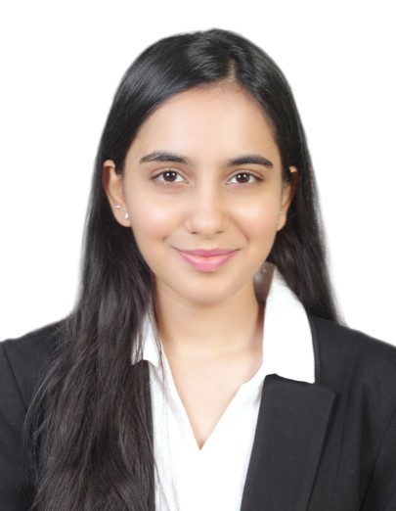
THANK
YOU
Dharmi Gala – A014
Dhruv Goyal – A018
Aman Jain – A021
Mahi Shah – A037

